Slide 1
Strengthening the resilience of local food systems Renforcer la résilience des systèmes alimentaires dans les territoires
SOMMET CLIMATE CHANCE EUROPE AFRIQUE 2025 / CLIMATE CHANCE EUROPE AFRICA 2025 SUMMIT

Slide 2
Round table – Table ronde
Speakers Intervenants
Alina Bekka Cité de l'agriculture (Marseille), co-directrice
Marie Goumarre Métropole d’Aix Marseille Provence, Cheffe de projet résilience alimentaire
Salima Djidel Vice-présidente de Grenoble Alpes Métropole
Giaime Berti Chair of the Resilient Local Food Supply Chains Alliance
Florent Yann Lardic Directeur de Terres en villes, réseau français des politiques alimentaires locales
.
SOMMET CLIMATE CHANCE EUROPE AFRIQUE 2025 / CLIMATE CHANCE EUROPE AFRICA 2025 SUMMIT

Slide 3
Anchoring Just Food Transitions: cooperation as infrastructure Alina Bekka, La Cité de l’agriculture
SOMMET CLIMATE CHANCE EUROPE AFRIQUE 2025 / CLIMATE CHANCE EUROPE AFRICA 2025 SUMMIT

Slide 4
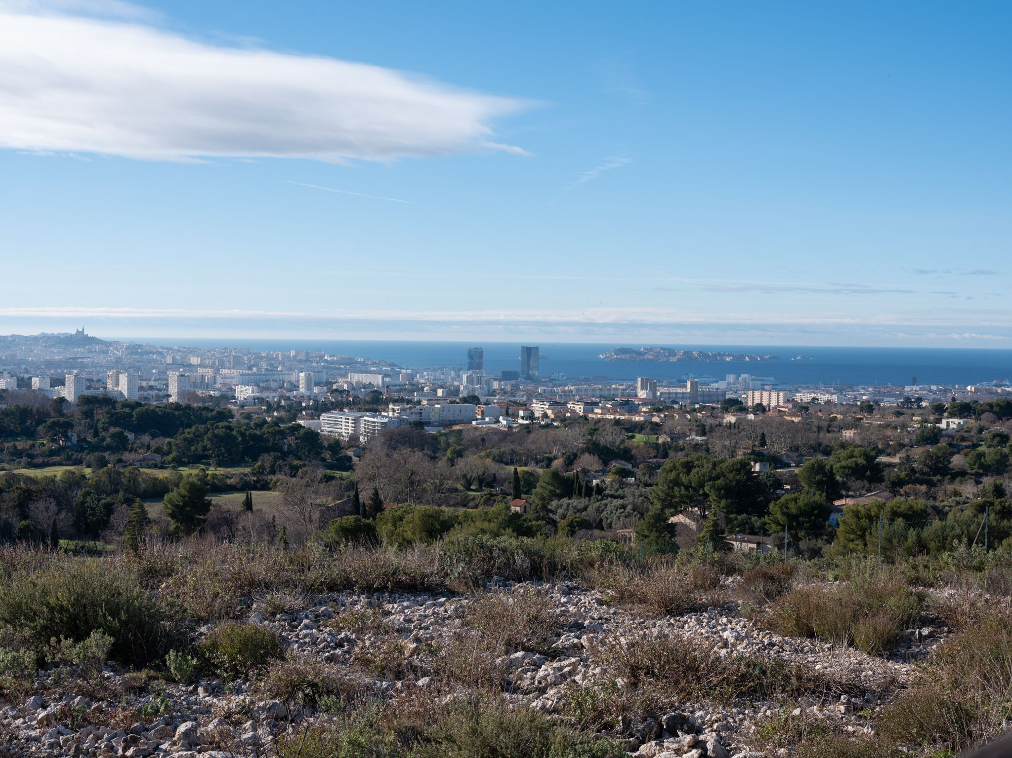
Marseille, a city rooted in agriculture, hungry for food justice
Agricultural richness ↔ Structural vulnerabilities
Resilience = rebuilding food systems through justice, care, participation
Copyright Geoffroy Mathieu
.
SOMMET CLIMATE CHANCE EUROPE AFRIQUE 2025 / CLIMATE CHANCE EUROPE AFRICA 2025 SUMMIT

Slide 5
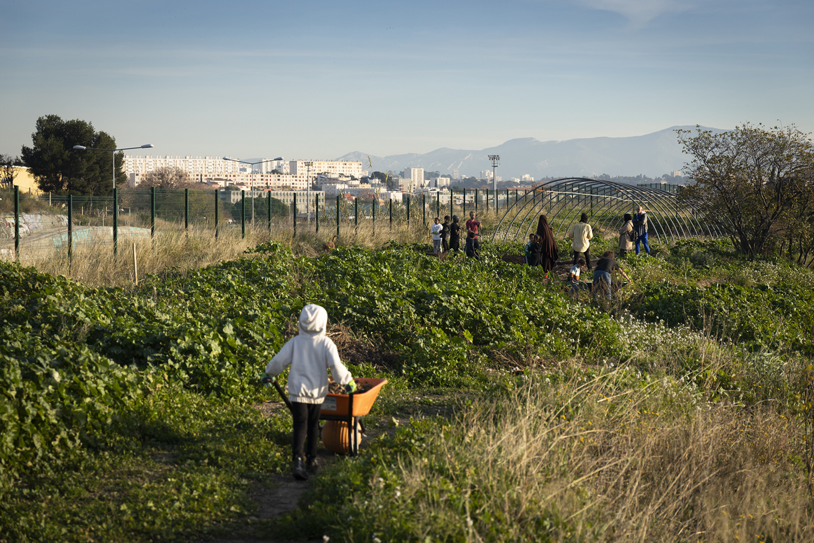
La Cité de l’agriculture: a living lab for the ecological and just transition of food systems
> Action-research
> Training & Support
> Influence and advocacy
> Territorial Cooperation
> Public Engagement
Capri urban farm: Copyright Edwige Lamy
.
SOMMET CLIMATE CHANCE EUROPE AFRIQUE 2025 / CLIMATE CHANCE EUROPE AFRICA 2025 SUMMIT

Slide 6
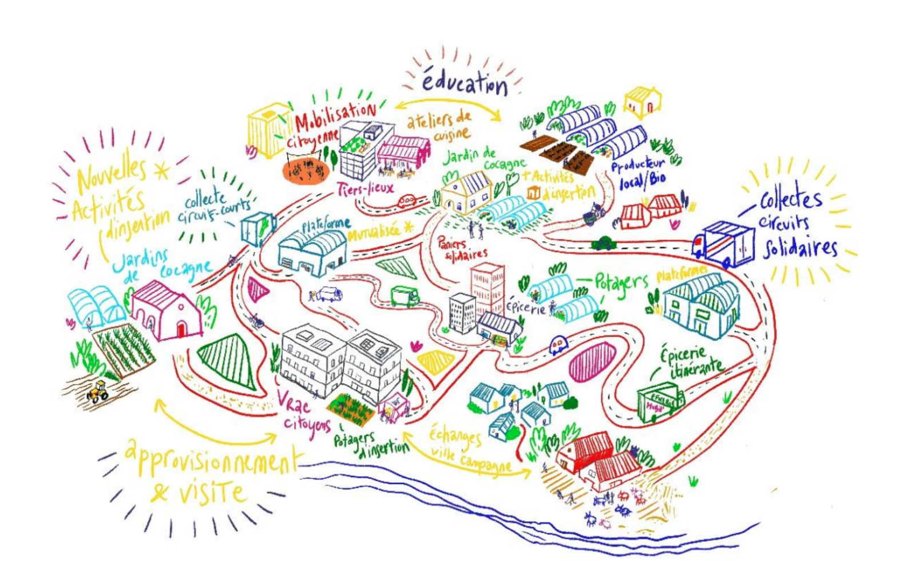
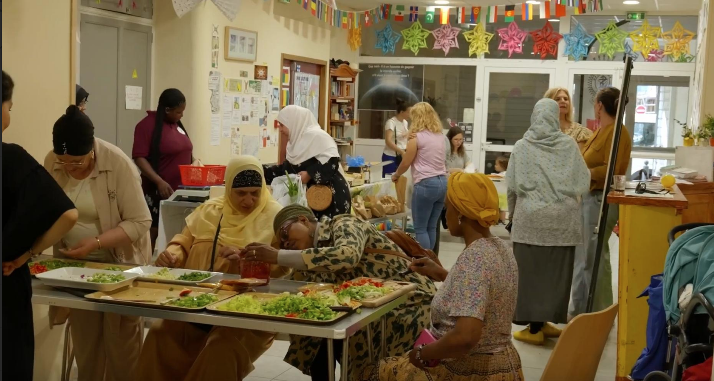
Territoires à VivreS Marseille: Transforming Food Access and Experimenting Food Democracy
> 10 local actors: producers, social groceries, NGOs > Key tool: logistics platform (social local farm, 5 groceries) Governance space: shared values, visits, advocacy → Dignified accessibility + transformation of the paradigm accross the food chain
COMAC: collective dynamic to set locally-adapted social food security into motion
.
SOMMET CLIMATE CHANCE EUROPE AFRIQUE 2025 / CLIMATE CHANCE EUROPE AFRICA 2025 SUMMIT

Slide 7
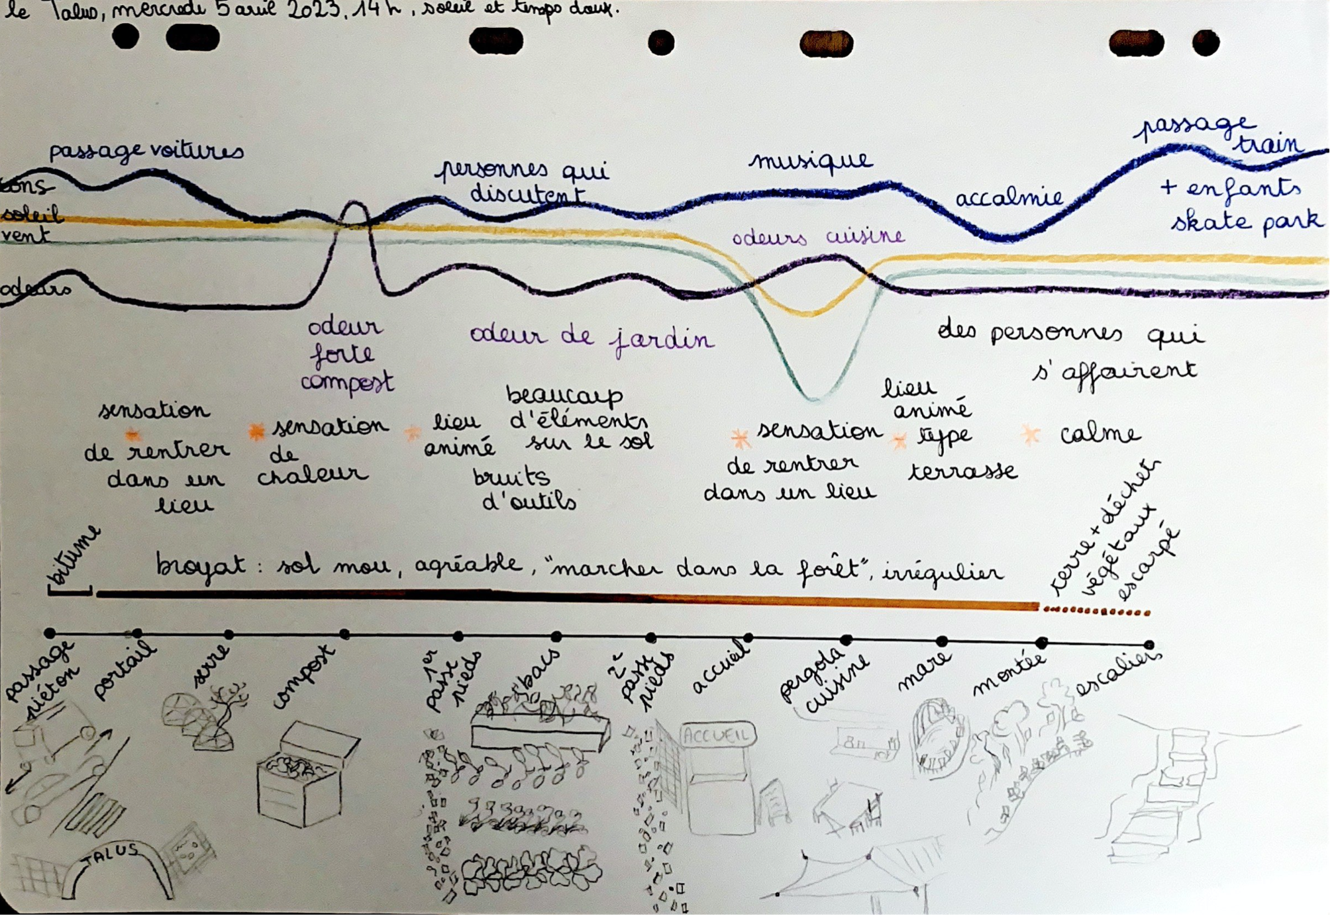
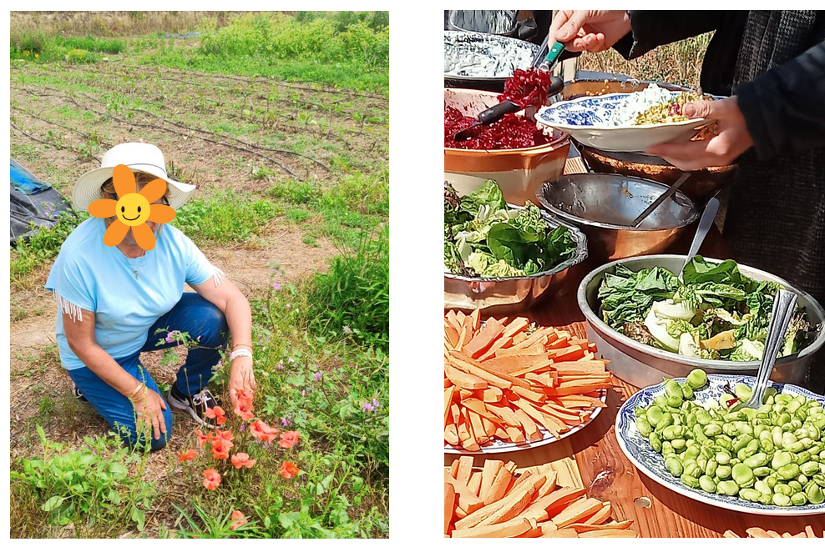
CAJAU: inclusion and hospitality of urban agriculture
Research-action with 3 sites + NGOs + sociologist Methods: interviews, photo-elicitation, sensory mapping
Findings: - Access is not only physical - Implicit codes matter (language, signage, behavior) - Hospitality = multiple uses, care, mediation
Sensory map of an urban farm
Photos from a participant at one of the farms
Scaling up: URBAN HI project (handbook, tools, brief)
.
SOMMET CLIMATE CHANCE EUROPE AFRIQUE 2025 / CLIMATE CHANCE EUROPE AFRICA 2025 SUMMIT

Slide 8
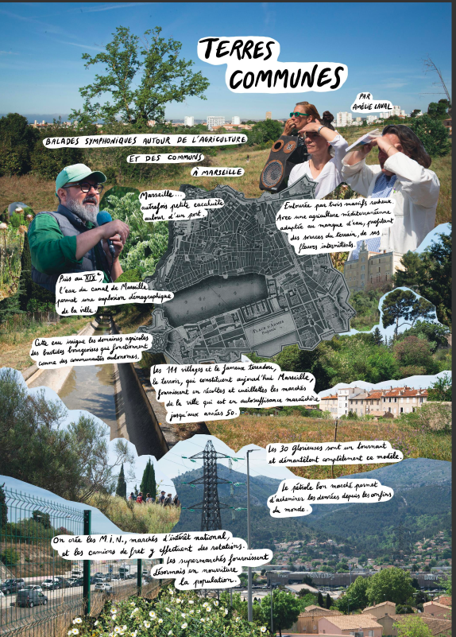
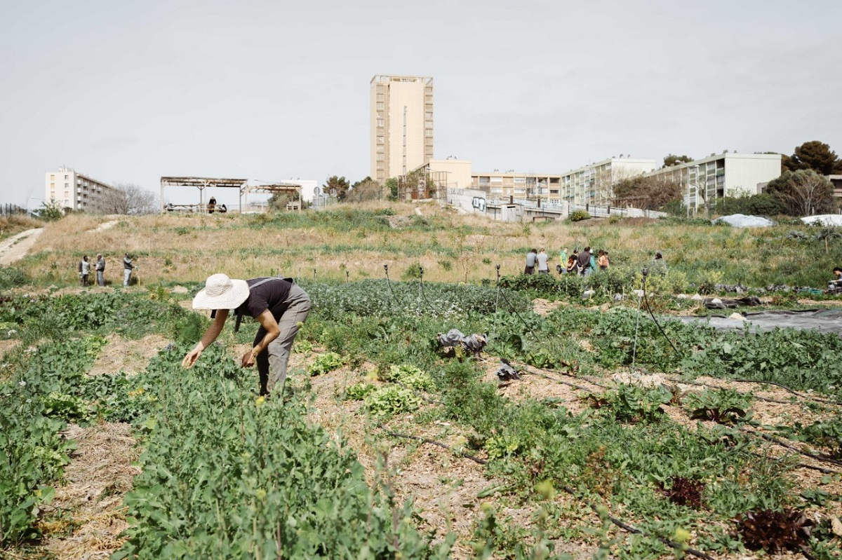
Cooperation as infrastructure
Reconnecting the dots: - Production & accessibility - Logistics & relationships - Redistribution & recognition
Scaling resilience = scaling cooperations: call for public action
Up: Capri urban farm
(copyright Jeanne Mercier)
Right: Rendition of a multistakeholder, multi-method event « common lands »
.
SOMMET CLIMATE CHANCE EUROPE AFRIQUE 2025 / CLIMATE CHANCE EUROPE AFRICA 2025 SUMMIT

Slide 9
Supporting interscalar actions: Marseille metropolitan authority example Marie Goumarre, Métropole Aix-Marseille-Provence
SOMMET CLIMATE CHANCE EUROPE AFRIQUE 2025 / CLIMATE CHANCE EUROPE AFRICA 2025 SUMMIT

Slide 10
Scaling up urban food policies: Grenoble metropolitan authority example Salima Djidel, Vice-présidente Grenoble Alpes Métropole
SOMMET CLIMATE CHANCE EUROPE AFRIQUE 2025 / CLIMATE CHANCE EUROPE AFRICA 2025 SUMMIT

Slide 11
Advocacy contributions
Les Assises territoriales de la transition agroécologique et de l’alimentation durable :
THE POWER TO ACT CHARTER
Europe :
Restoring the Green Deal and its ‘Farm to Fork’ initiative
A Common Agricultural and Food Policy (CAFP)
European regulation on sustainable food systems
The systematic negotiation of environmental and social mirror clauses and the strengthening of traceability requirements
A renewed framework for public procurement
National government :
An ambitious National Food, Nutrition and Health Strategy
Empowering local and regional authorities (shared responsibility, funding)
Multi-annual funding of 440 territorial food projects to the tune of €80 million a year.
A significant increase in the budget earmarked to support the organic sector, the reinstatement of maintenance aid, and the introduction of a framework scheme to extend Payments for Environmental Services (PES)..
Private sector :
Fair pay for all producers and workers in the food sector
Support for local, organic and fair-trade sectors
Transparency for consumers on the origin and conditions of production
Promoting healthy, less-processed food, sustainable meat production practices.
A network of processing facilities to help structure local production chains and promote local quality products
.
SOMMET CLIMATE CHANCE EUROPE AFRIQUE 2025 / CLIMATE CHANCE EUROPE AFRICA 2025 SUMMIT

Slide 12
Levers of cooperation between local food systems around the world Giaime Berti, Chair of the Resilient Local Food Supply Chains Alliance
SOMMET CLIMATE CHANCE EUROPE AFRIQUE 2025 / CLIMATE CHANCE EUROPE AFRICA 2025 SUMMIT

Slide 13
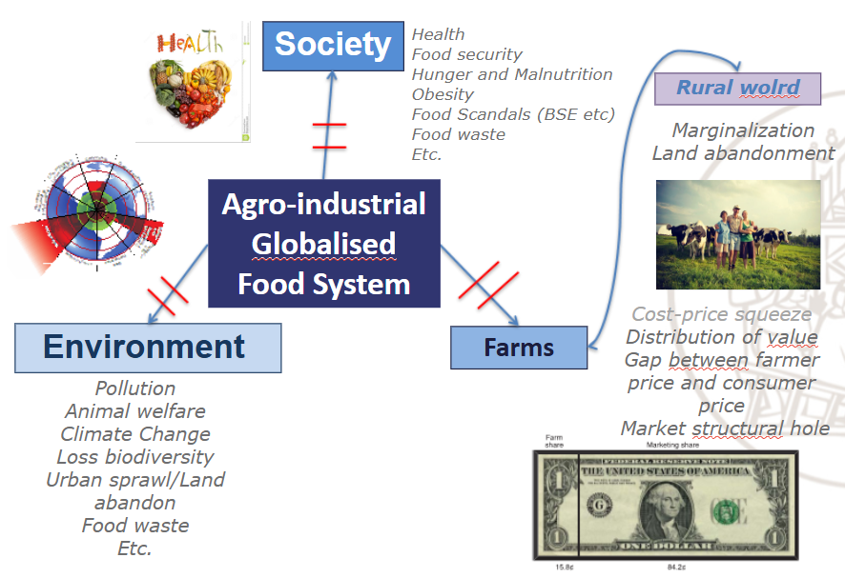
The issue at the stake: the crisis of the conventional food system
.
SOMMET CLIMATE CHANCE EUROPE AFRIQUE 2025 / CLIMATE CHANCE EUROPE AFRICA 2025 SUMMIT

Slide 14
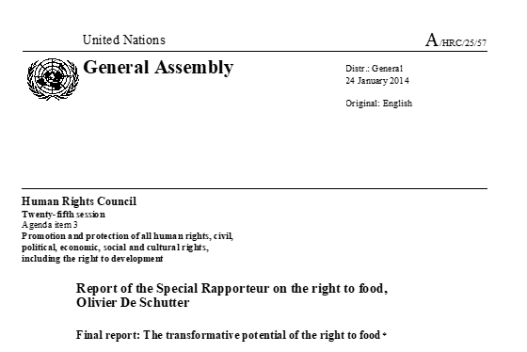
A way foreward towards sustainable food systems
“measured against the requirement that they should contribute to the realization of the right to food, the food systems we have inherited from the twentieth century have failed from economic, social end environmental point of view”.
The key to transition is to rebuild local food systems, thus decentralizing food systems and making them more flexible, but also creating links between the cities and their rural hinterland, for the benefit both of local producers and of consumers.
.
SOMMET CLIMATE CHANCE EUROPE AFRIQUE 2025 / CLIMATE CHANCE EUROPE AFRICA 2025 SUMMIT

Slide 15
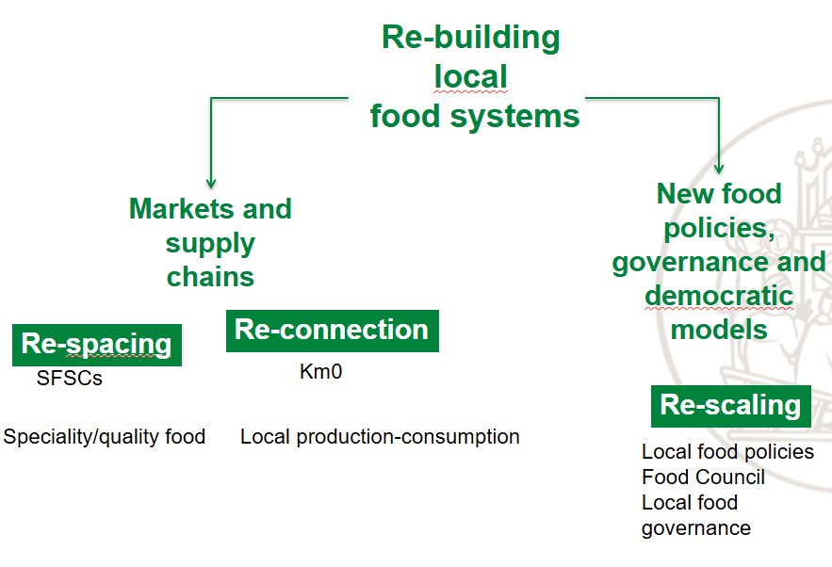
Territorialisation of the food system: local action
.
SOMMET CLIMATE CHANCE EUROPE AFRIQUE 2025 / CLIMATE CHANCE EUROPE AFRICA 2025 SUMMIT

Slide 16
Territorialisation of the food system: global advocacy
Fixing 'broken' global food system
«Global food systems are broken and billions of people are paying the price».
UN Secretary-General Antonio Guterres
Set the stage for global agrifood systems transformation to achieve the SDGs.
«radical transformation in how food is produced, processed, traded and consumed is required»​
.
SOMMET CLIMATE CHANCE EUROPE AFRIQUE 2025 / CLIMATE CHANCE EUROPE AFRICA 2025 SUMMIT

Slide 17
Territorialisation of the food system: global advocacy
Objectives of the UNFSS+4 :
Reflecting on progress: Reflecting on achievements and identifying lessons learned, while analyzing the factors that have enabled success in various contexts. This will provide a foundation for understanding gaps and scaling transformative solutions.
2. Strengthening accountability: Engaging state and non-state actors in mutual accountability mechanisms to assess commitments, track progress, and identify missing elements, fostering an inclusive environment where all stakeholders can contribute meaningfully to food systems transformation.
3. Unlocking investments: Exploring opportunities for financing innovations and scaling solutions, with a focus on creating enabling environments, leveraging public-private partnerships, and mobilizing climate and development finance to support transformative actions at scale.
.
SOMMET CLIMATE CHANCE EUROPE AFRIQUE 2025 / CLIMATE CHANCE EUROPE AFRICA 2025 SUMMIT

Slide 18
The UN Food System Summit
COALITIONS OF ACTION:
Groups of organisations and/or institutions (State and/or non-State actors) assembled to challenge business as usual and champion an integrated, systemic approach at scale to address specific issue related to food systems.
In each case, the coalition members’ priority is to catalyse the achievement of the Sustainable Development Goals (SDGs) by supporting national pathways for food systems transformation by 2030.
They commit to doing so in line with the principles, targets, and indicators of the 2030 Agenda.
Self-organised and independent strucured according the following principles:
Country-driven
Systemic and transformative
Inclusive and based on coordination
Accountable
Action-oriented development finance to support transformative actions at scale.
.
SOMMET CLIMATE CHANCE EUROPE AFRIQUE 2025 / CLIMATE CHANCE EUROPE AFRICA 2025 SUMMIT

Slide 19
RLFSC Alliance
.
SOMMET CLIMATE CHANCE EUROPE AFRIQUE 2025 / CLIMATE CHANCE EUROPE AFRICA 2025 SUMMIT

Slide 20
RLFSC Alliance: governance
Members Forum – comprise of countries, research
institutions, academia, private sector, youth groups, women’s groups, NGOs, indigenous people​
​
Steering Group – Chair Italy​
​
Task Forces​
Research and Innovation​
Finance and Investment​
Knowledge Sharing/Management​
Short Value Chains​
​
The Secretariat​
The Secretariat is hosted from WFP to AUDA-NEPAD​
​
The Alliance Coordination Team (ACT)​
WFP, AUDA-NEPAD, UN CDF, FAO​
​
​
The Declaration of Commitment​
Partners are requested to sign a Declaration of Commitment that will confirm their participation in the Alliance and commitment to its mission and objectives. ​
This document is not legally binding but demonstrates a willingness to work together in partnership, to share successes, challenges and best practices and benefit from the activities of the Alliance.​
.
SOMMET CLIMATE CHANCE EUROPE AFRIQUE 2025 / CLIMATE CHANCE EUROPE AFRICA 2025 SUMMIT

Slide 21
RLFSC Alliance: activities
OBJECTIVE 1: ADVOCACY AND PARTNERSHIPS ​
At global, regional and national levels for the use of integrated approaches to build resilient local food supply chains, using its partners’ reach and influence as champions and holding side events coordinated and led by partners ​
​
OBJECTIVE 2: FACILITATE PEER-PEER KNOWLEDGE SHARING, EXPERTISE AND EXPERIENCES
Foster peer-to-peer exchange of best practices knowledge of technical expertise, facilitating of peer exchange field visits and provide experts and tools to sub-national/local, national and regional systems – leveraging partners’ knowledge and expertise as examples from different regions.
​
OBJECTIVE 3: FACILITATE TECHNICAL SUPPORT TO NATIONAL AND REGIONAL SYSTEMS AND SCOPING MISSIONS
Objective three includes mobilising traditional and non-traditional partners (private sector, foundations) in support of countries’ efforts to identify and develop interventions and programmes that address country priorities.
​
OBJECTIVE 4: RESEARCH AND INNOVATION:
Scientific, academia, private sector and financing experts that are partners will be in the vanguard to provide studies, hold webinars and workshops through their partner networks that will highlight advances in research and technology, innovative financing, climate action (mitigation and adaption), especially for inclusion of marginalised groups and to advance countries’ priorities. ​
OBJECTIVE 5: RESOURCE MOBILISATION IDENTIFY AND PROPOSE FINANCING MECHANISMS
Jointly with Alliance partners seek funding to enhance domestic financing and complement existing funding to support implementation, capacity building, oversight and reporting and other priorities identified by partners​
​
.
SOMMET CLIMATE CHANCE EUROPE AFRIQUE 2025 / CLIMATE CHANCE EUROPE AFRICA 2025 SUMMIT

Slide 22
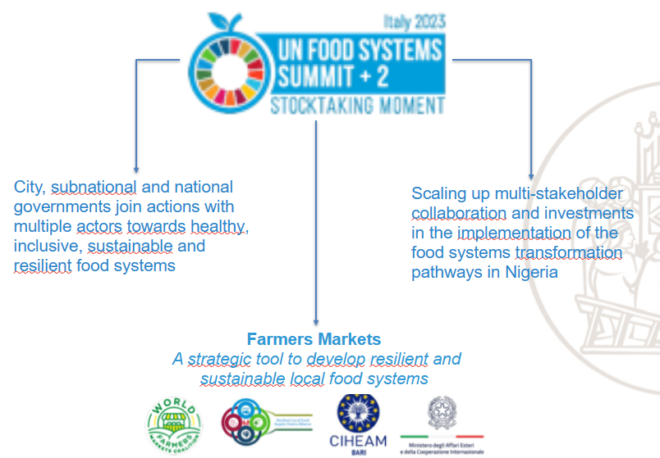
RLFSC Alliance advocacy
.
SOMMET CLIMATE CHANCE EUROPE AFRIQUE 2025 / CLIMATE CHANCE EUROPE AFRICA 2025 SUMMIT

Slide 23
RLFSC Alliance advocacy
.
SOMMET CLIMATE CHANCE EUROPE AFRIQUE 2025 / CLIMATE CHANCE EUROPE AFRICA 2025 SUMMIT

Slide 24
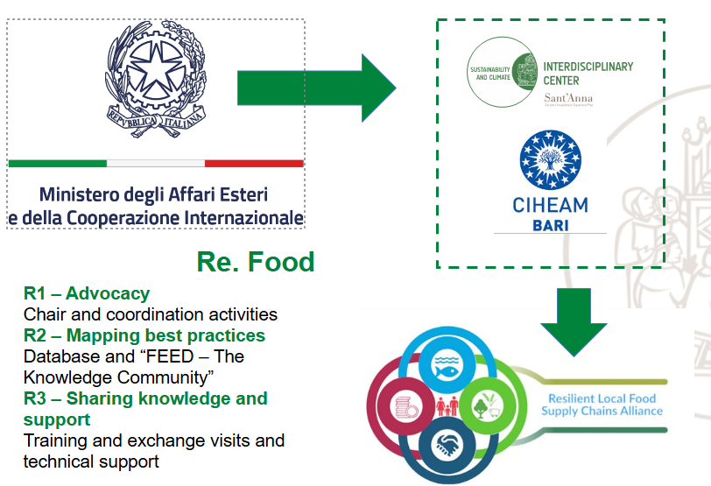
Italy and RLFSC Alliance
.
SOMMET CLIMATE CHANCE EUROPE AFRIQUE 2025 / CLIMATE CHANCE EUROPE AFRICA 2025 SUMMIT

Slide 25
Re.food
Result ​ | Title​ | Objectives​
Result 1​ | Advocacy Support​ | Increasing the number of Countries partners (at least 5 new Egypt, Tunisia, Keya, Senegal, Ethiopia )​ ​ Strengthening the RLFSC Alliance advocacy capacity​
Result 2​ | Mapping and sharing best practices​ | 100 best practices on local food systems ( from Italy and around the globe) mapped and shared ​ ​ Promoting discussion among RLFSC Alliance partners trough thematic working groups​
Result 3​ | Training, expertise and experiences exchange, technical support​ ​ | Training 10 people on local food systems planning and and participatory governance​ ​ Experiences exchange: scoping mission of Italian local food supply chains’ representatives in 5 Countries ​ ​ Technical support for local food system planning (5 Countries) through living labs ​ Projects design: ​ 2 local project, ​ African Observatory on local food systems​
.
SOMMET CLIMATE CHANCE EUROPE AFRIQUE 2025 / CLIMATE CHANCE EUROPE AFRICA 2025 SUMMIT

Slide 26
Re.food and UNFSS + 4 objectives
Reflecting on Progress in food systems transformation​
Policy paper on the importance of developing local food supply chains for Countries to build resilience and food security and for progressing to the transition towards sustainable, inclusive, just, health food systems. ​
Mapping best practices to reflect on achievements and identifying lessons learned. They also provide foundation for understanding gaps and scaling transformative solutions.​
Strengthening Accountability:​
Increasing the number of partners and involvement of networks and organisations engaged in developing local food systems in the RLFSC Alliance ​
Unlocking Investments for food systems:​
Mapping best practices, will provide concrete examples for financing innovations and scaling solutions,​
Capacity building in 5 countries, strenghten local capacity to implement projects ​
2 pilot projects for the development of resilient local food systems ​
African Observatory on local food system​
.
SOMMET CLIMATE CHANCE EUROPE AFRIQUE 2025 / CLIMATE CHANCE EUROPE AFRICA 2025 SUMMIT

